Slide 1

Predicting customer buying behaviour
29/01/2024 – Vanshika jassal

Slide 2
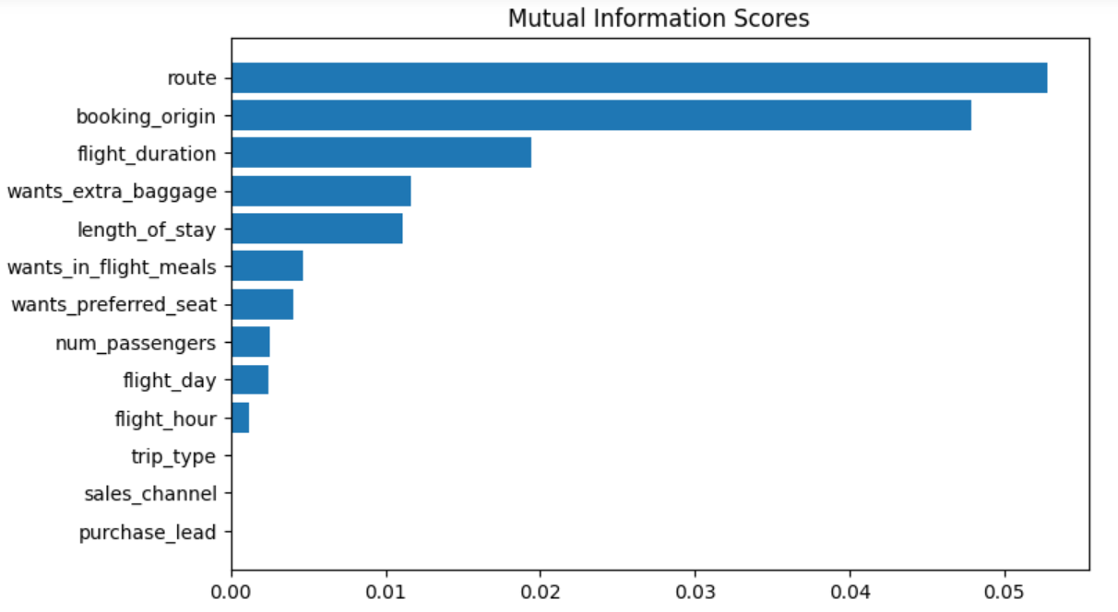
predictive model to understand factors that influence buying behaviour
We have trained the data set with Random forest classifier model and received :
ACCURACY: 84.76
AUC score: 0.535
route
booking_origin
flight_duration
wants_extra_baggage
length_of_stay
are the top 5 features which influence
Customer buying behavior
We need to increase the AUC score.

